Slide 1


Movie Data Analysis - Full Project

Slide 2


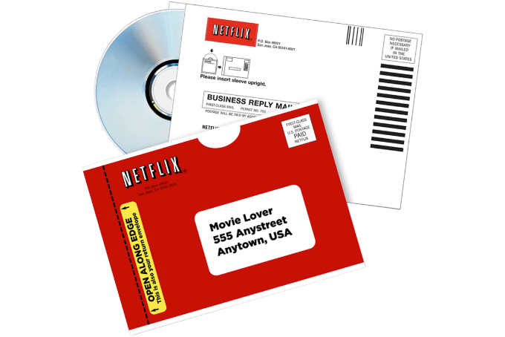
Netflix Movie Data Analysis Project
Netflix, founded on August 29, 1997, in Scotts Valley, California, by Reed Hastings and Marc Randolph, began as a DVD-by-mail service. Hastings, a computer scientist and mathematician, co-founded the company after being inspired by a hefty late fee from a traditional video rental store. Randolph, a marketing executive, played a pivotal role in shaping Netflix's early user interface and branding.

Slide 3

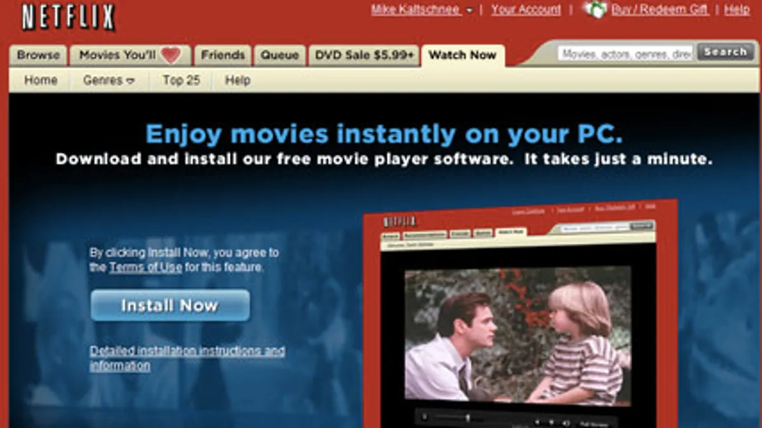
Netflix Movie Data Analysis Project
In 2007, Netflix introduced streaming services, allowing subscribers to watch movies and TV shows instantly online. This strategic shift capitalized on the growing internet bandwidth and changing consumer preferences, propelling Netflix into a leading global streaming platform. By 2010, the company began its international expansion, starting with Canada, and by 2016, it was available in over 190 countries.

Slide 4

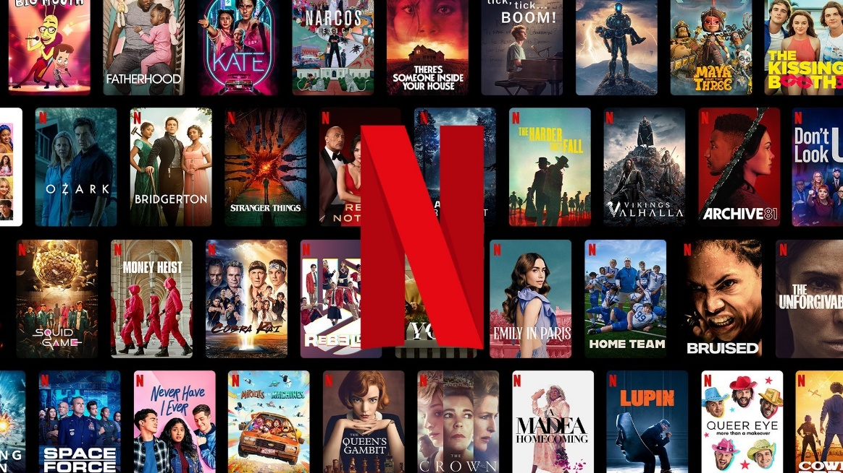
Netflix Movie Data Analysis Project
As of 2024, Netflix reported a revenue of nearly $10 billion in the third quarter, with profits reaching $2.4 billion.
The platform boasts over 283 million paid memberships across more than 190 countries, offering a vast library of TV series, films, and games in various genres and languages.
Overall, Netflix's evolution from a DVD rental service to a global streaming giant underscores its adaptability and innovative approach in the entertainment industry.

Slide 5
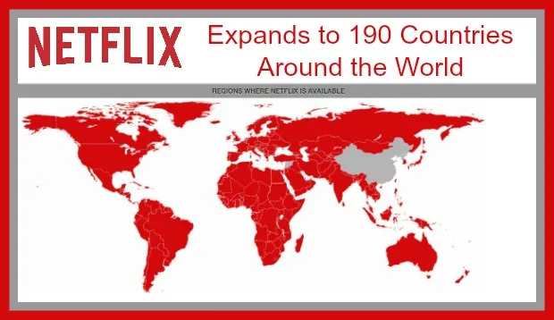
Netflix Movie Data Analysis Project

Slide 6
Netflix Movie Data Analysis Project
Netflix is known for its work in data science, AI, and ML, particularly for building strong recommendation models and algorithms that understand customer behavior and patterns. Suppose we are working in a data-driven job role, and we have a dataset of more than 9,000 movies. We need to solve the following questions to help the company make informed business decisions accordingly.
What is the most frequent genre of movies released on Netflix?
Which genre has highest votes in vote avg column?
What movie got the highest popularity? what's its genre?
What movie got the lowest popularity? what's its genre?
Which year has the most filmed movies?

Slide 7
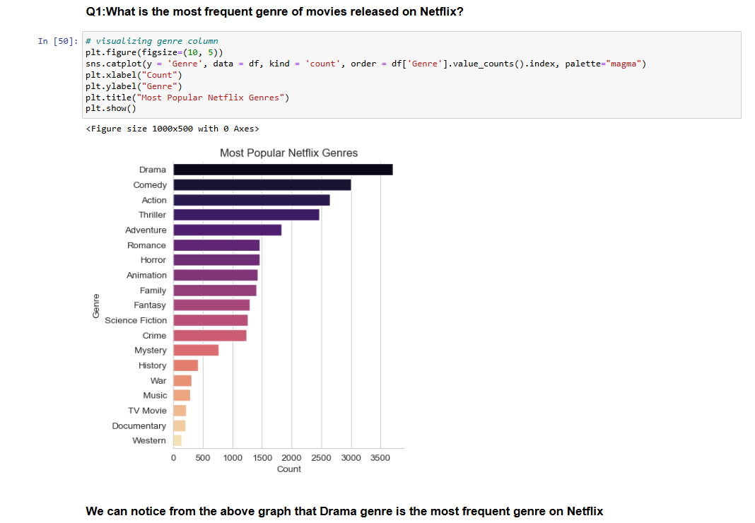

Slide 8
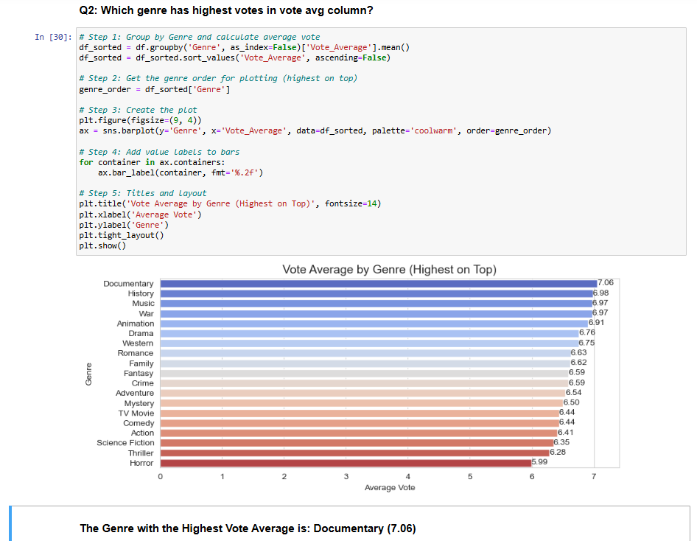

Slide 9
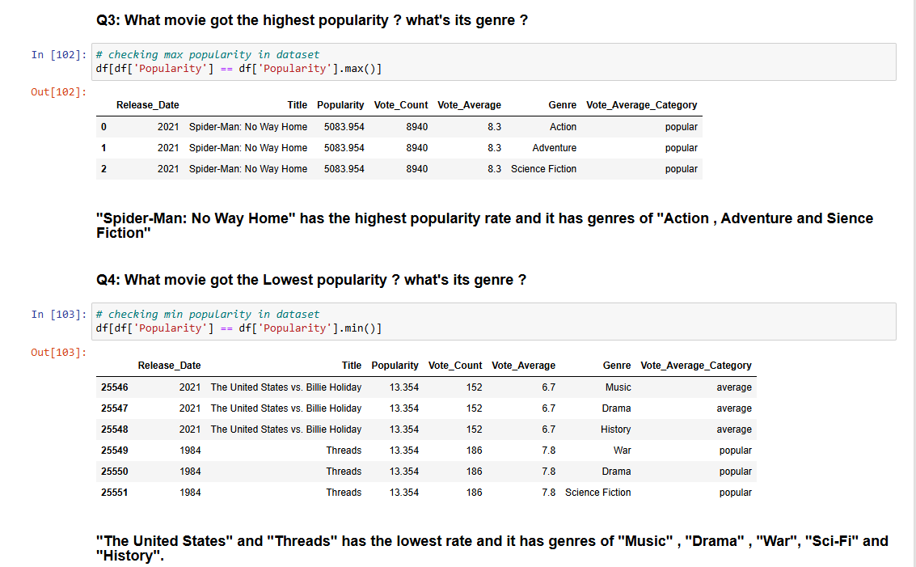

Slide 10
